Slide 1

Puberty
Year 7 Health – 2024
Lesson 9

Slide 2

Today’s focus
Revision for upcoming test.

Slide 3

(pg. 81)
In the first 5 minutes of each lesson, you will complete your revision page, you will find these throughout your booklet.
The revision page consists of three questions. It will need to be completed in detail. One-word answers will not be accepted.
The three questions :
What two concepts or ideas did I learn in class last week?
What did I find interesting about last week’s lesson? Provide a specific example.
Any questions or new words you have learnt?
The teacher will go over this each lesson with you to see what you have learnt. It is a great way for you to revisit content and test your memory.

Slide 4
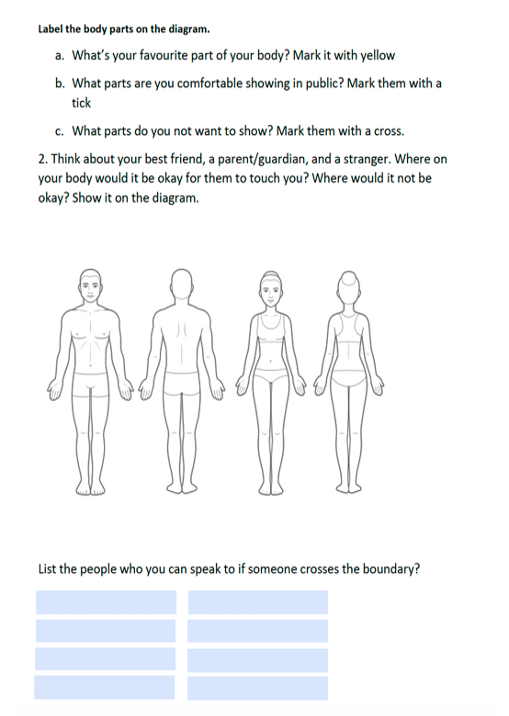
Hook: (pg.82)
PUBLIC & PRIVATE BODY PARTS
Our body is exactly that – OUR BODY.
We get to decide who has access to it and it what capacity.
Complete the worksheet in your books and reflect on what parts of your body you would consider public and private.
Notes:
OPTIONAL
Discuss this worksheet as a class and explain that they should never be made to do any activities with their body (particularly sexual) if they do not want to/do not consent to it.
If students are ever made to feel unsafe, then they should report it to a trusted adult.

Slide 5
Revision Options:
Revision booklet for students to work through.
Puberty Memory Game.
  One class set located in the Health storeroom.
  One pack of cards per group.
  Place all cards face down on the table. Students flip a card over and read it and try and match it to its correct partner (question and answer).
Kahoot!
  https://create.kahoot.it/share/the-joys-of-puberty/992434db-fbec-4c3e-8e22-d7c61f64b17a

